Slide 1
Religion, Polarization and Secularism: A Postmodern Critique
Joseph Tham and Allister Lee
Pontificio Ateneo Regina Apostolorum

Slide 2
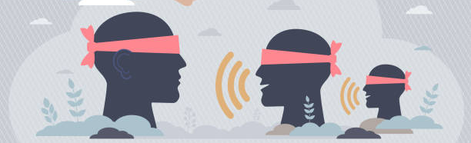
Research Question
To examine the possible causes of polarisation by expounding on the criticisms of religious bioethics by secular bioethics, and vice versa.
To propose methods to mitigate the existing polarisation by offering a reading of The Dialectics of Secularisation by Jürgen Habermas and Joseph Ratzinger.

Slide 3
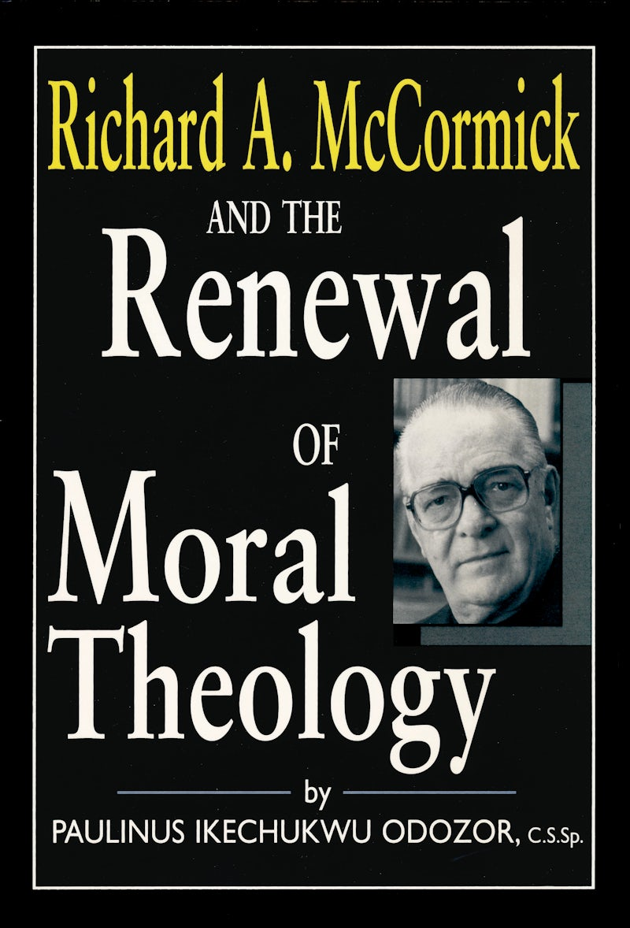
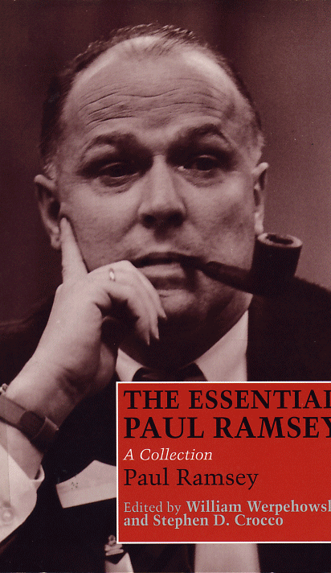
The Marginalization of Religious Bioethics

Slide 4
Secularization of bioethics
1966-1970: 22% Religious bioethics literature
1986-1990: 6.2%

Slide 5
What was lost in Process?
Breakdown of a common narrative
Alasdair MacIntyre, After Virtue
Possible alternatives
Will to power (Nietzsche, Rorty)
Veil of Ignorance (Rawls, Habermas)
Might is right (Engelhardt)

Slide 6
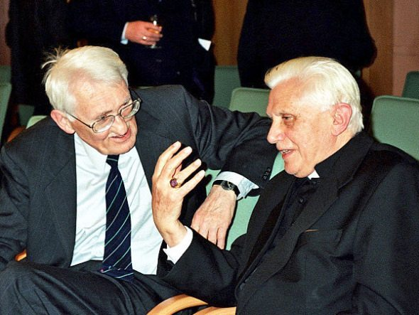
The Dialectics of Secularisation
2004 Jürgen Habermas and Joseph Ratzinger.
Habermas urging that “secular society acquire a new understanding of religious convictions”
What are the prerequisites to create a just society.
Ratiionalism vs. fideism

Slide 7
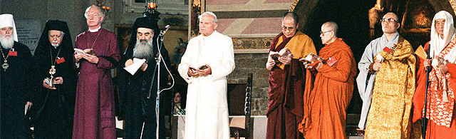
Post-Secular Dialogue in Bioethics
Habermas
Religious citizens should abandon their “claim to a monopoly” in understanding human existence.
Secularised citizens “must not deny in principle that religious image of the world have the potential to express truth”.
Translate religious language into “a language that is accessible to the public as a whole”?

Slide 8
Post-Secular Dialogue in Bioethics
Ratzinger
“Religion and reason restrict each other and remind each other where limits are”
Dialogue should take on intercultural forms and engage with other traditions.
Human Rights
Human Dignity
Human Nature

Slide 9
Conclusion
Without a shared narrative, bioethical discussion becomes futile and interminable. This phenomenon is particularly salient between religious and secular bioethics due to mutual scepticism.
Genuine dialogue is necessary. This involves a collaboration of devising a common language that is understandable by both religious and secular participants.

